Slide 1

Computer Science An Overview
13th Edition
Chapter 4
Networking and
the Internet

Slide 2
Chapter 4: Networking and the Internet
4.1 Network Fundamentals
4.2 The Internet
4.3 The World Wide Web
4.4 Internet Protocols
4.5 Simple Client Server
4.6 Security

Slide 3
4.1 Network Fundamentals
Network Software allows users to exchange information and share resources
  Content
  Software
  Data storage facilities
Network software has evolved into a network-wide operating system

Slide 4
Network Classifications
Scope
  Personal Area Network (short-range)
  Local Area Network (building/campus)
  Metropolitan Area Network (community)
  Wide Area Network (greater distances)
Ownership
  Closed versus open
Topology (configuration)
  Bus (Ethernet)
  Star (Wireless networks with central Access Point)

Slide 5
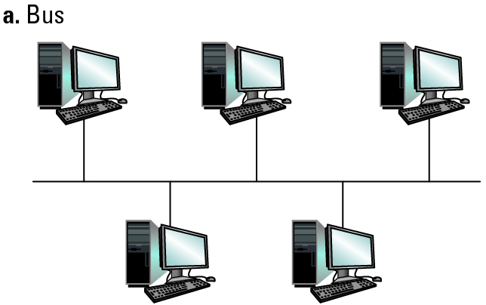
Figure 4.1 Two popular network topologies (1 of 2)

Slide 6
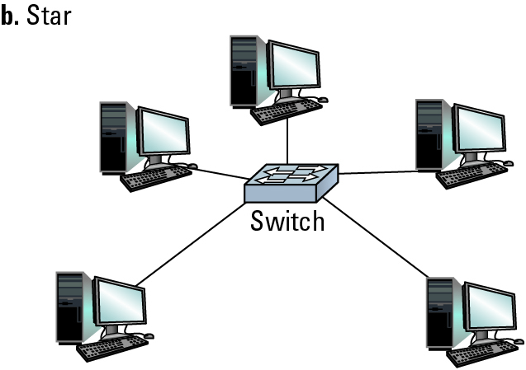
Figure 4.1 Two popular network topologies (2 of 2)

Slide 7
Protocols
Rules by which activities are conducted on a network
  Example: Coordinating the transmission of messages between computers
    Need to avoid all machines transmitting at the same time
Allows vendors to build products that are compatible with products from other vendors

Slide 8
Protocols for Transmitting Messages
CSMA/Collision Detection
  used in Ethernet
  both machines stop and wait for a independent, random time
CSMA/Collision Avoidance
  used in WiFi, where not all machines can hear each other (hidden terminal problem)
  give advantage to the machine that has already been waiting

Slide 9
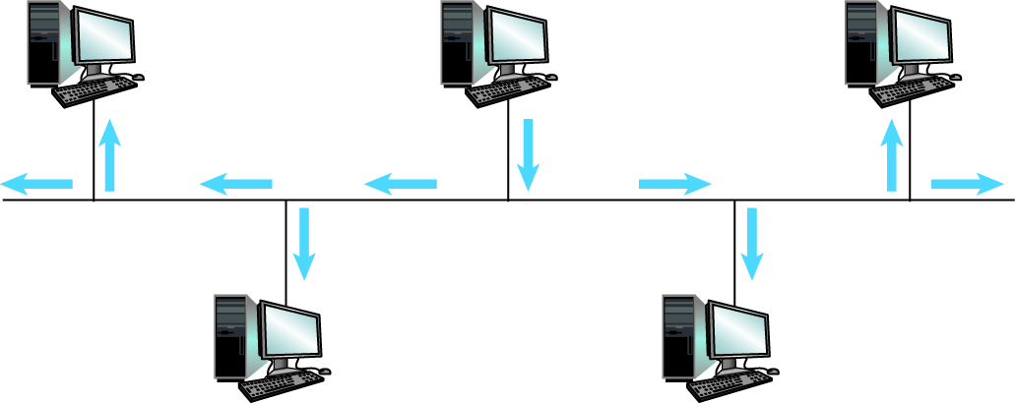
Figure 4.2 Communication over a bus network

Slide 10
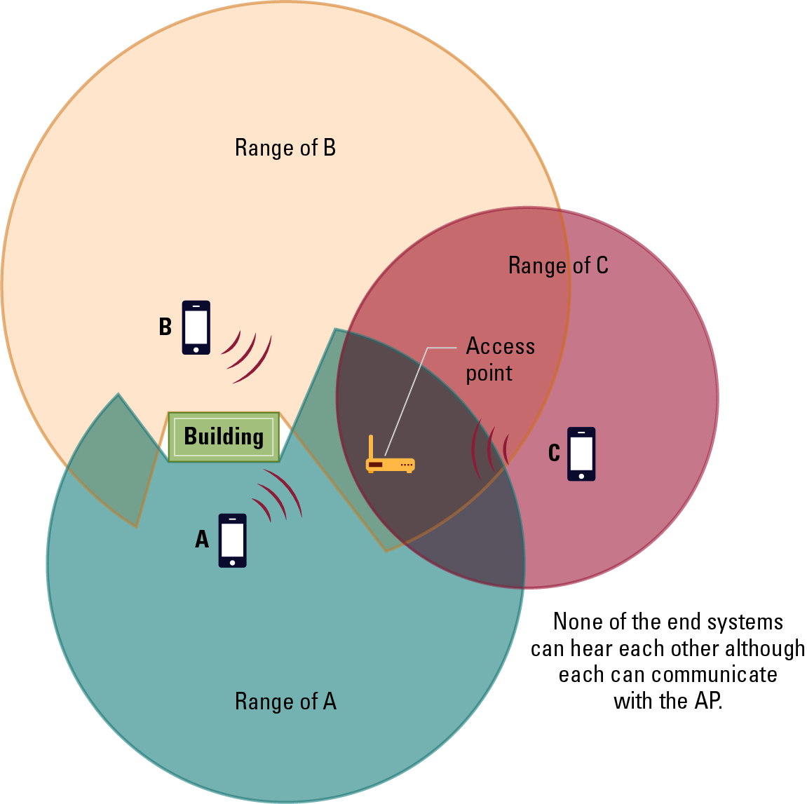
Figure 4.3 The hidden terminal problem
Notes:
None of the end systems can hear each other although each can communicate with the Access Point

Slide 11
Combining Networks
Repeater: passes all messages across two busses
Bridge: passes only messages that are destined for computers on the other bus
Switch: acts like a bridge, but with connections to multiple busses
Router: Connects two incompatible networks
resulting in a network of networks called an internet

Slide 12
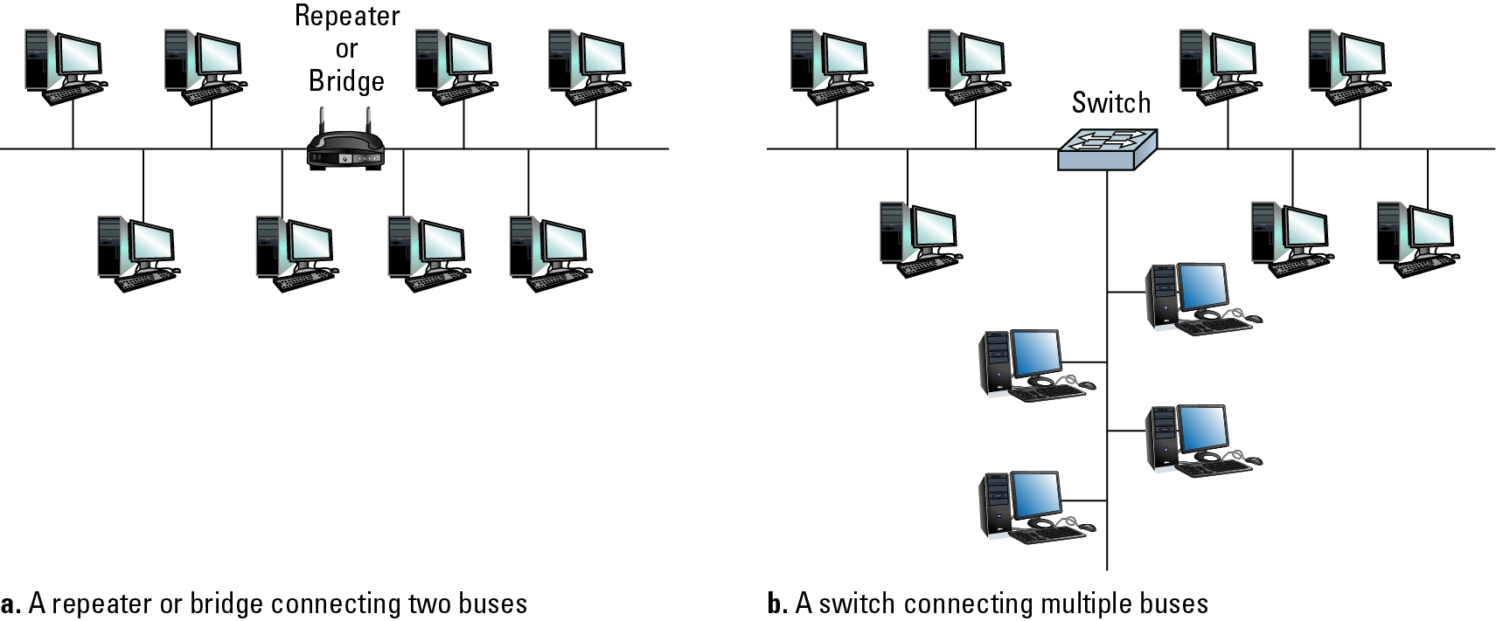
Figure 4.4 Building a large bus network from smaller ones

Slide 13
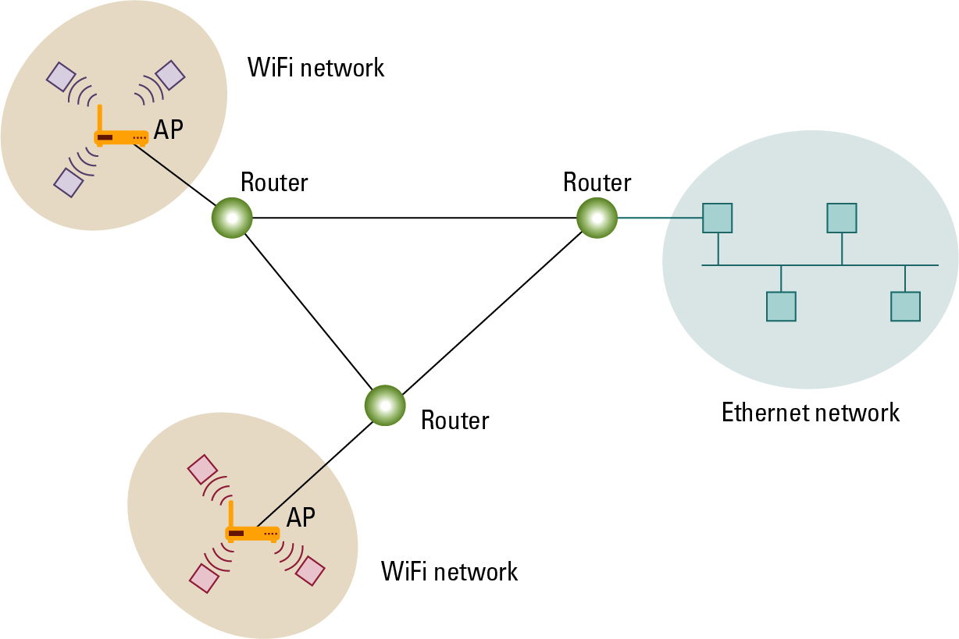
Figure 4.5 Routers connecting two WiFi networks and an Ethernet network to form an internet

Slide 14
Methods of Process Communication
Client-server
  Many clients, one server (executing continuously)
  Clients make requests of other processes
  Server satisfies requests made by clients
Peer-to-peer (P2P)
  Two processes communicating as equals
  Processes execute on a temporary basis

Slide 15
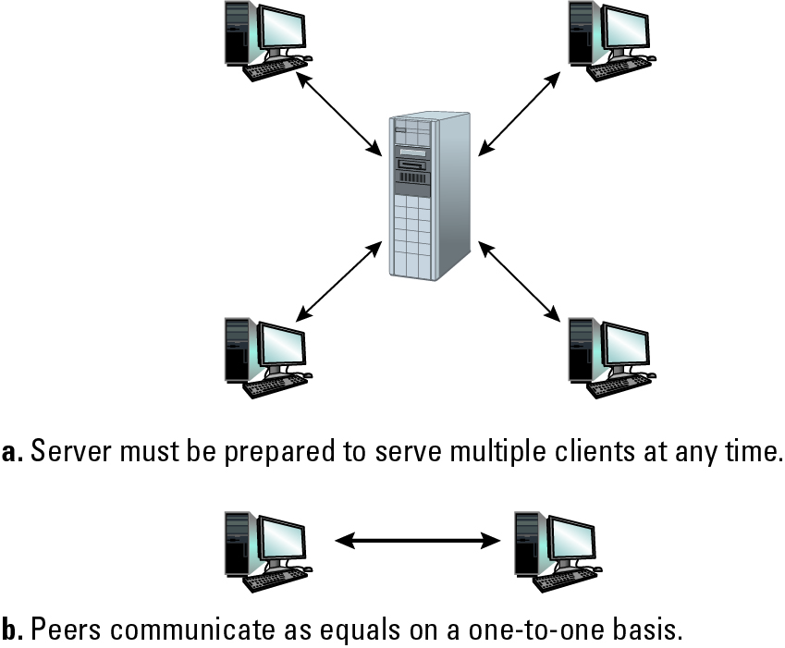
Figure 4.6 The client/server model compared to the peer-to-peer model
Notes:
Server must be prepared to serve multiple clients at any time
Peers communicate s equals on a one-to-one basis

Slide 16
Distributed Systems
Systems units that execute as processes on different computers
  Cluster computing
    Independent computers work closely together instead of a single, much larger machine
  Grid computing
    Millions of home PCs (not connected to each other) work on a complex problem
  Cloud computing
    Provide services, hide the details

Slide 17
4.2 The Internet
The Internet is an internet that spans the world
  Original goal was to link a variety of networks into a connected system unaffected by local disasters
  Today, it is a commercial undertaking that links a worldwide combination of PANs, LANs, MANs, and WANs involving millions of computers

Slide 18
Internet Architecture
Internet Service Provider (ISP)
  Tier-1 (Internet backbone)
  Tier-2
Access or Tier-3 ISP: Provides connectivity to the Internet
  Hot spot (wireless)
  Telephone lines
  Cellular
  Cable/Satellite systems

Slide 19
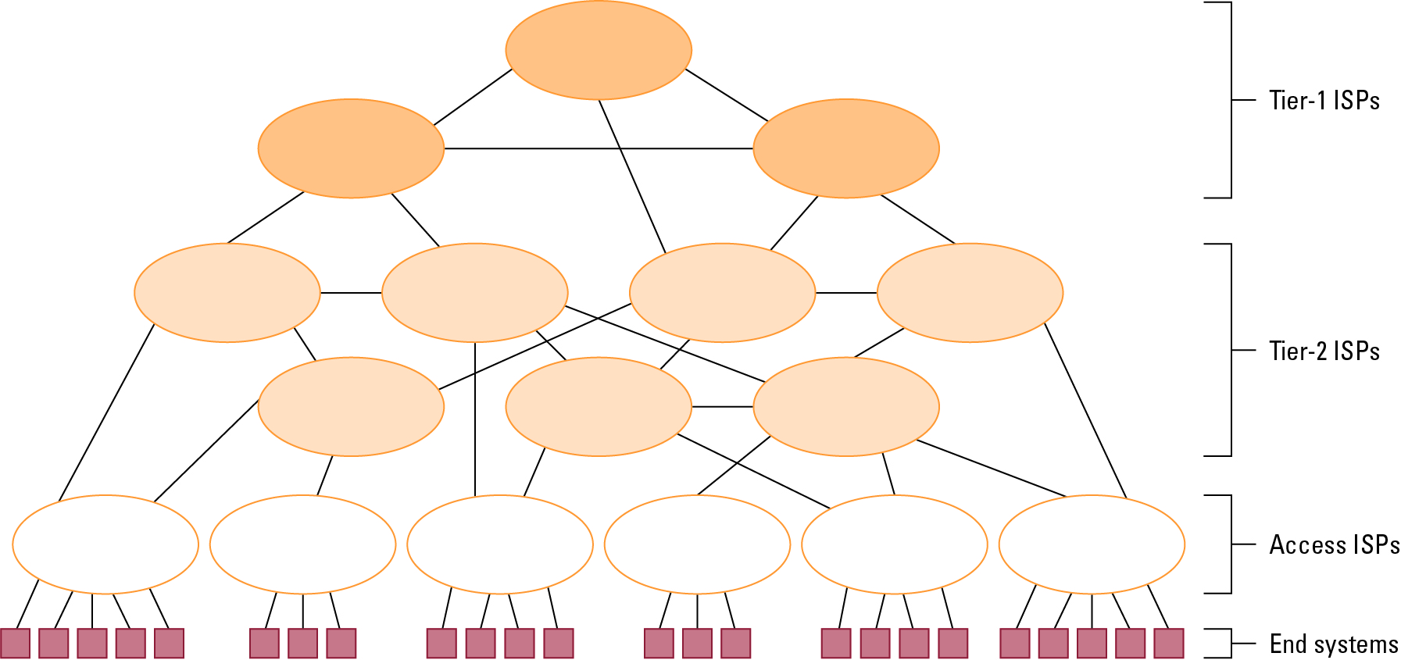
Figure 4.7 Internet Composition
Notes:
Tier-1 ISPs
Tier-2 ISPs
Access ISPs
End Systems

Slide 20
Internet Addressing
IP address: pattern of 32 or 128 bits often represented in dotted decimal notation
Mnemonic address:
  Domain names (mu.edu)
  Top-Level Domains
    .org, .gov, .com, .mil, .net, .au, .ca, .biz, ….
Domain name system (DNS)
  Name servers
  DNS lookup

Slide 21
Internet Corporation for Assigned Names & Numbers (ICANN)
Allocates blocks of IP addresses to ISPs who then assign those addresses within their regions.
Oversees the registration of domains and domain names.

Slide 22
Early Internet Applications
Network News Transfer Protocol (NNTP)
File Transfer Protocol (FTP)
Telnet and Secure Shell (SSH)
Hypertext Transfer Protocol (HTTP)
Electronic Mail (email)
  Domain mail server collects incoming mail and transmits outing mail
  Mail server delivers collected incoming mail to clients via POP3 or IMAP

Slide 23
SMTP Simple Mail Transfer Protocol
220 mail.tardis.edu SMTP Sendmail Gallifrey-1.0; Fri, 23 Aug 2413 14:34:10
HELO mail.skaro.gov
250 mail.tardis.edu Hello mail.skaro.gov, pleased to meet you
MAIL From: dalek@skaro.gov
250 2.1.0 dalek@skaro.gov... Sender ok
RCPT To: doctor@tardis.edu
250 2.1.5 doctor@tardis.edu... Recipient ok
DATA
354 Enter mail, end with "." on a line by itself
Subject: Extermination.
EXTERMINATE!
Regards, Dalek
.
250 2.0.0 r7NJYAEl028071 Message accepted for delivery
QUIT
221 2.0.0 mail.tardis.edu closing connection

Slide 24
More Recent Applications
Voice Over IP (VoIP)
Internet Multimedia Streaming
  N-unicast
  Multicast
  On-demand streaming
  Content delivery networks (CDNs)

Slide 25
4.3 World Wide Web
Hypertext combines internet technology with concept of linked-documents
  Embeds hyperlinks to other documents
Browsers present materials to the user
Webservers provide access to documents
Documents are identified by URLs and transferred using HTTP

Slide 26
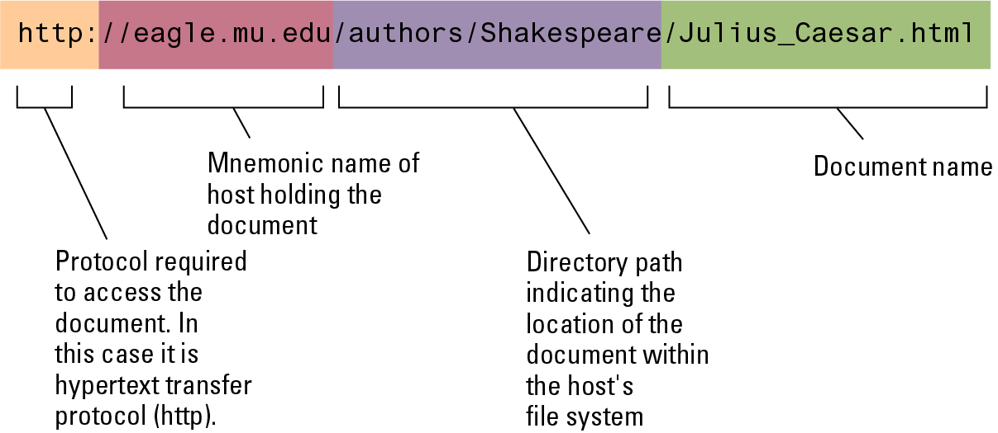
Figure 4.8 A typical URL
Notes:
http://eagle.mu.edu/authors/Shakespeare/Julius_Caesar.html

Slide 27
Hypertext Markup Language (HTML)
Encoded as text file
Contains tags to communicate with browser
  Appearance
    <h1> to start a level one heading
    <p> to start a new paragraph
  Links to other documents and content
    <a href = . . . >
  Insert images
    <img src = . . . >

Slide 28
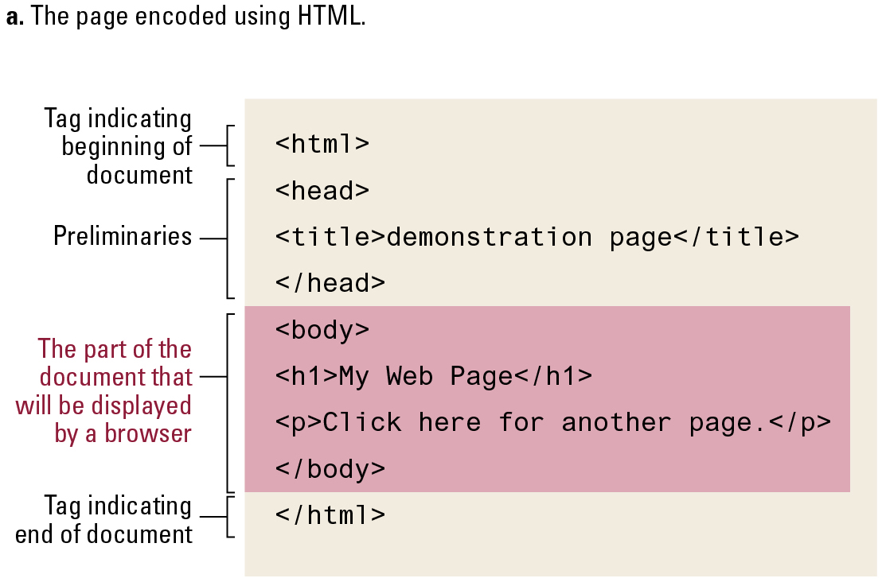
Figure 4.9 A simple webpage
Notes:
The page encoded using HTML

Slide 29
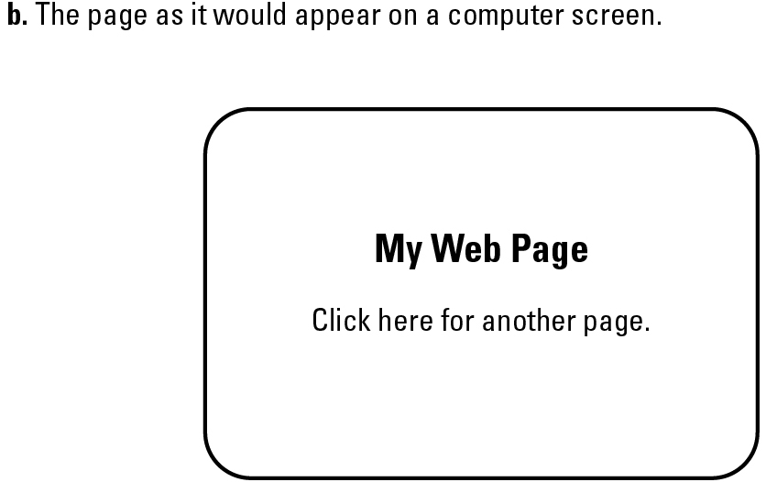
Figure 4.9 A simple webpage (continued)
Notes:
The page as it would appear on a computer screen

Slide 30
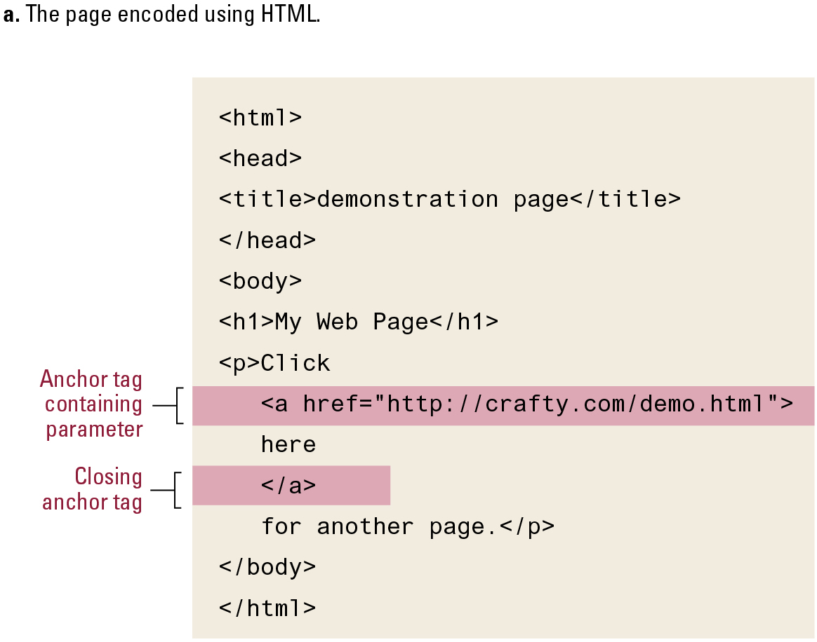
Figure 4.10 An enhanced simple webpage
Notes:
The page encoded using HTML

Slide 31
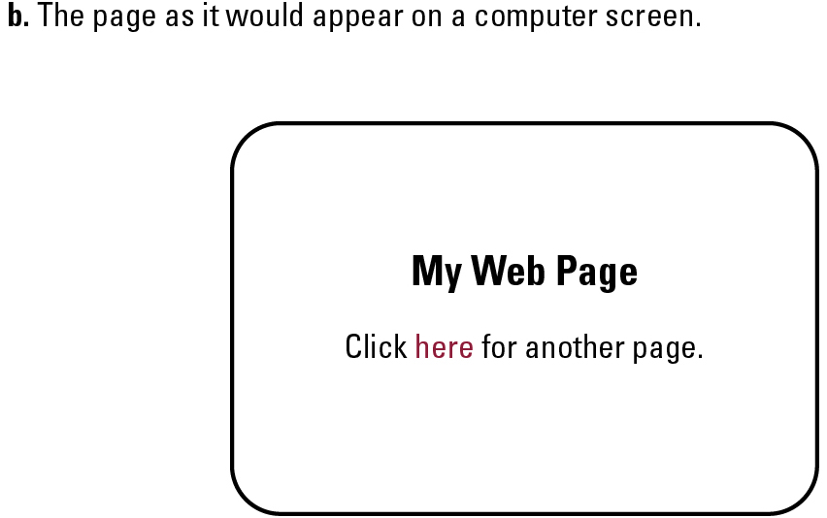
Figure 4.10 An enhanced simple Web page (continued)
Notes:
The page as it would appear on a computer screen

Slide 32
Extensible Markup Language (XML)
XML: A language for constructing markup languages similar to HTML
  A descendant of the Standard Generalized Markup Language
  Opens door to a World Wide Semantic Web

Slide 33
Using XML to encode music
<staff clef = “treble”> <key>C minor</key>
<time> 2/4 </time>
<measure> < rest> egth </rest> <notes> egth G, egth G, egth G </notes></measure>
<measure> <notes> hlf E </notes></measure>
</staff>

Slide 34
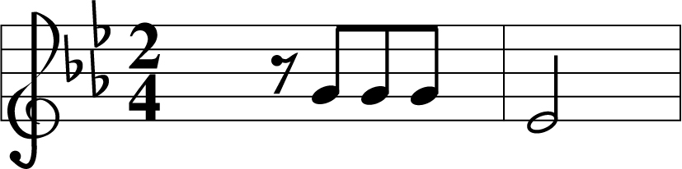
Figure 4.11 The first two bars of Beethoven’s Fifth Symphony

Slide 35
Client Side Versus Server Side
Client-side activities (browser)
  Javascript
  Java applets
  Macromedia Flash
Server-side activities (webserver)
  Common Gateway Interface (CGI)
  Servlets
  JavaServer Pages (JSP) / Active Server Pages (ASP)
  PHP

Slide 36
4.4 Internet Protocols
Control how messages are transferred over the Internet
This software must reside on every computer in the Internet
Accomplished by a multi-level hierarchy

Slide 37
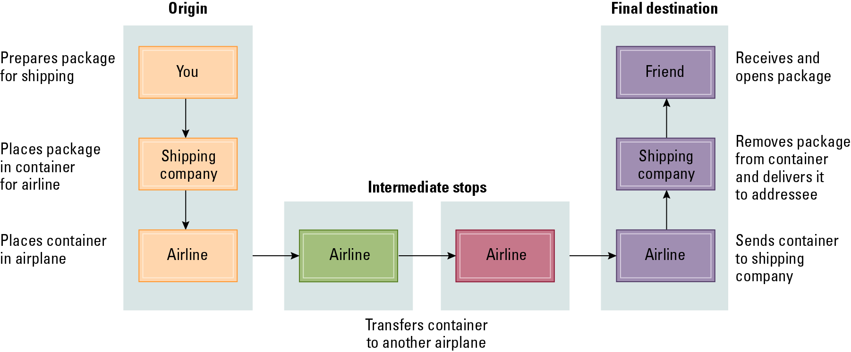
Figure 4.12 Package-shipping example

Slide 38
Internet Software Layers
Application: Constructs message with address
Transport: Chops message into packets
Network: Handles routing through the Internet
Link: Handles actual transmission of packets

Slide 39
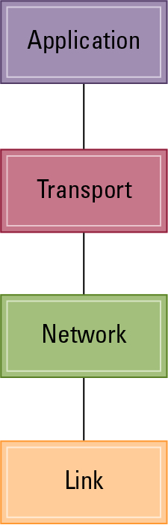
Figure 4.13 The Internet software layers

Slide 40
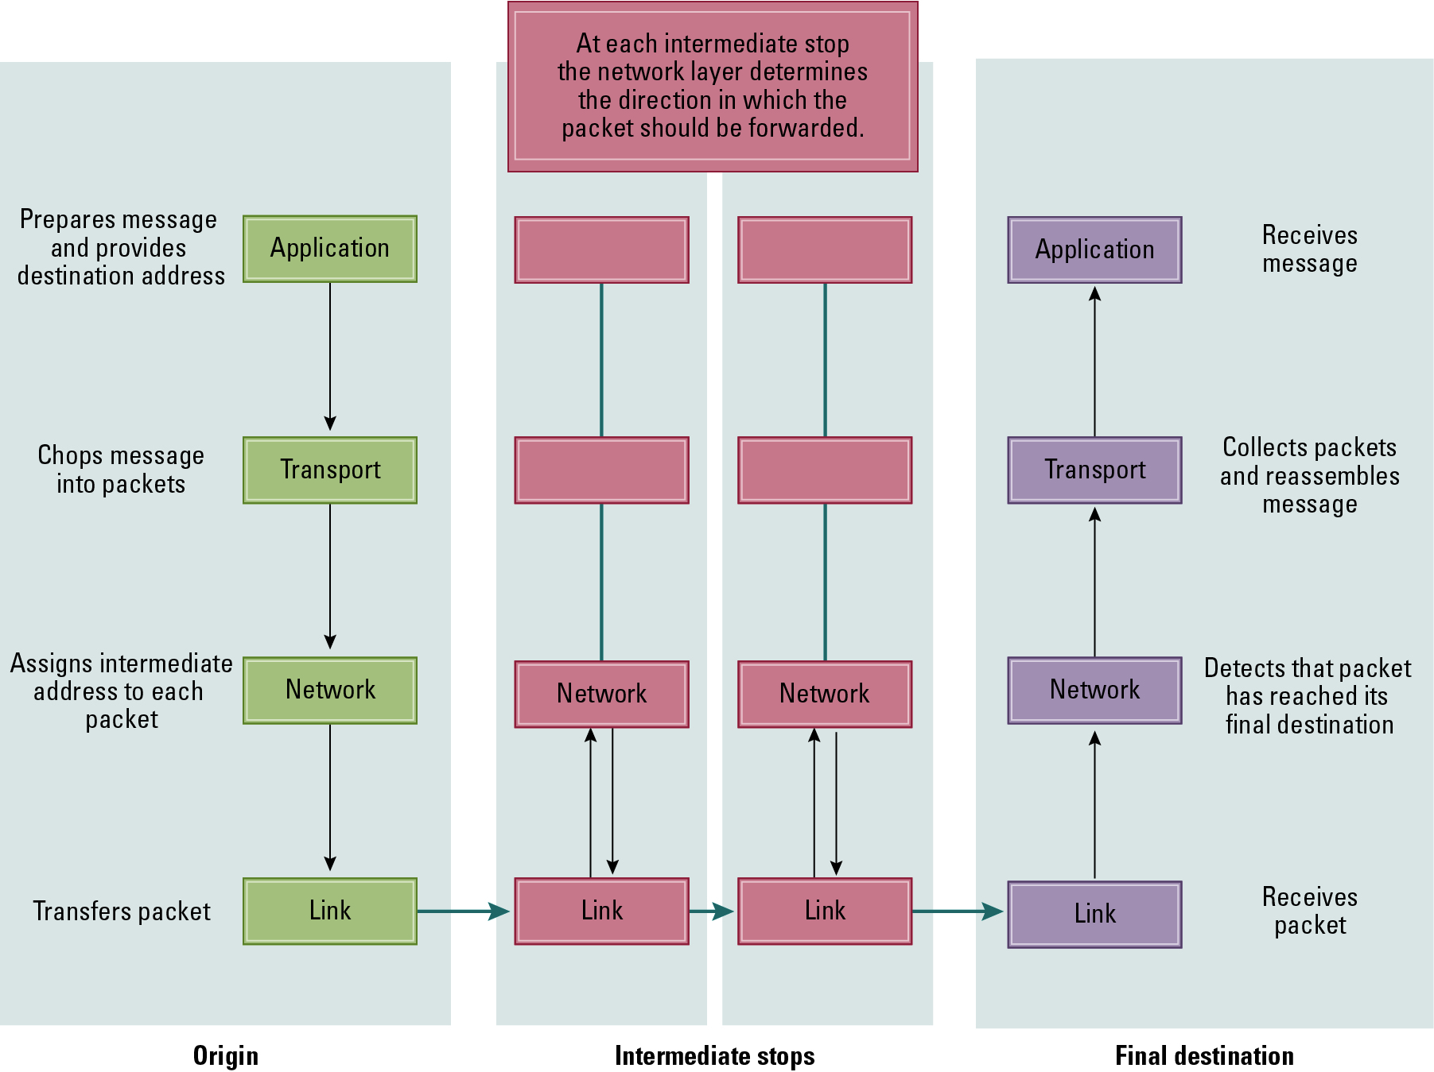
Figure 4.14 Following a message through the Internet

Slide 41
TCP/IP Protocol Suite
Transport Layer
  Transmission Control Protocol (TCP)
  User Datagram Protocol (UDP)
Network Layer
  Internet Protocol (IP)
    IPv4
    IPv6

Slide 42
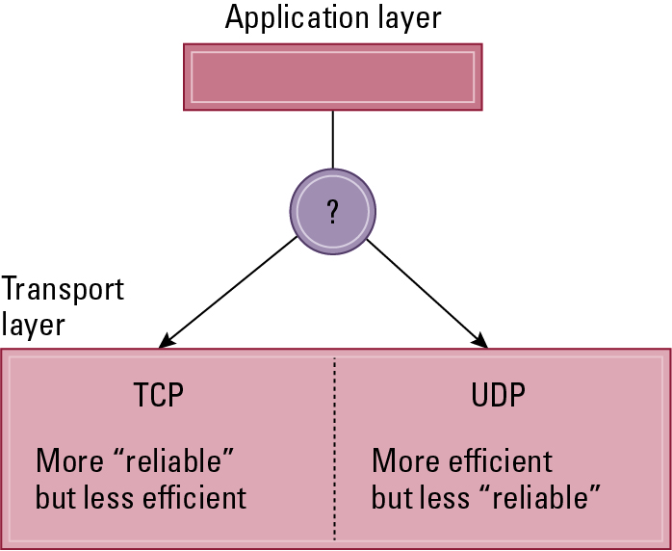
Figure 4.15 Choosing between TCP and UDP

Slide 43
4.5 Simple Client Server Program
Socket: an abstraction for processes at the application layer to connect to the network via the transport layer
  Needs to know
    Source Address name (localhost)
    Source Port number(1023…65535)
    Destination Address
    Destination Port number

Slide 44
Client Script in Python
import socket
Sock = socket.socket()
Server_address

Slide 45
Server Script in Python

Slide 46
4.6 Cybersecurity
Forms of Attack
  Malware (viruses, worms, Trojan horses, spyware, phishing software)
  Denial of service (DoS)
  Spam (common medium for delivering malware)
Protection and Cures
  Firewalls
  Spam filters
  Proxy Servers
  Antivirus software

Slide 47
Cryptography
HTTPS for secure Internet access
Public-key Encryption (asymmetric)
  Public key: Used to encrypt messages
  Private key: Used to decrypt messages
Certificate Authorities
  Trusted to maintain lists of public keys
  Provide Certificates to clients containing a party’s name and its public key

Slide 48
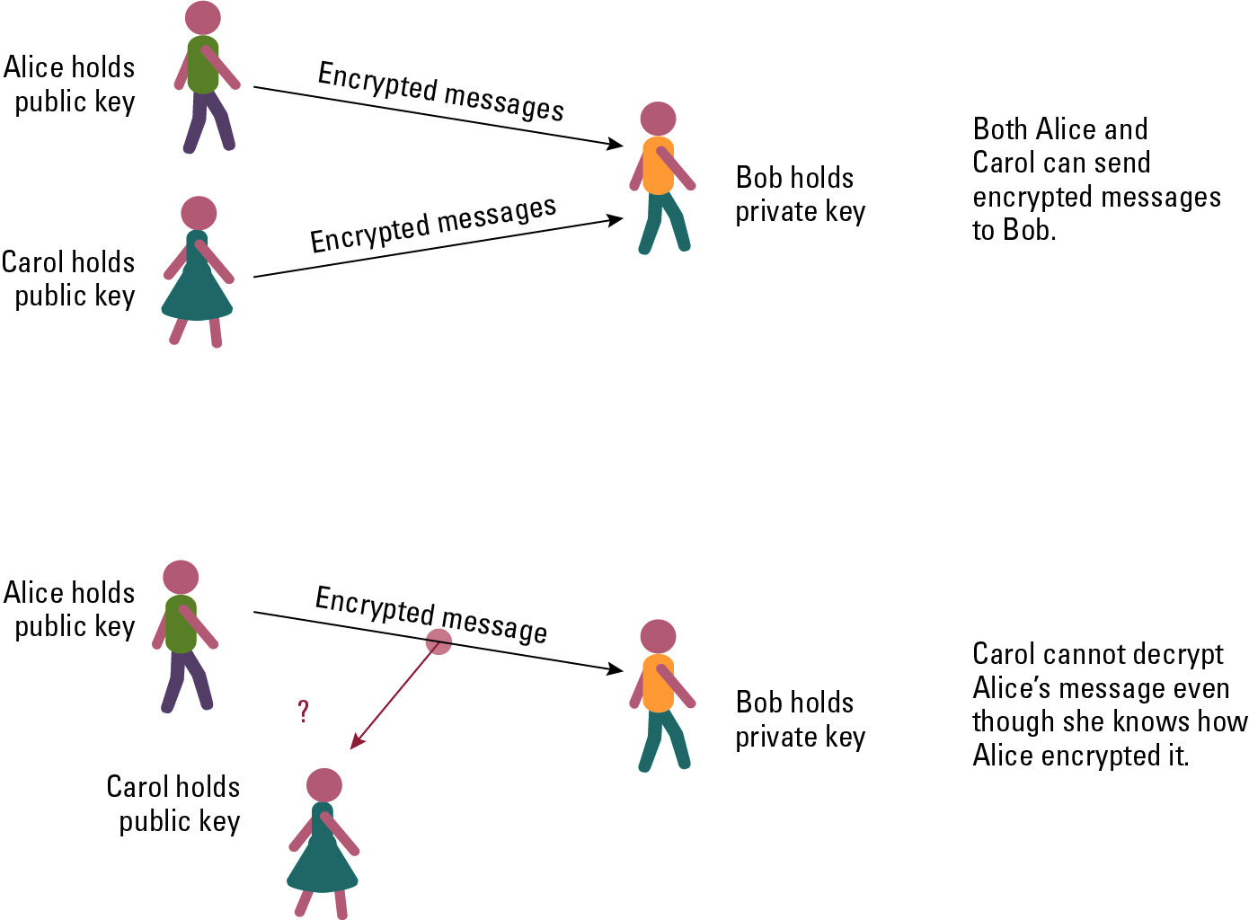
Figure 4.16 Public key encryption

Slide 49
Legal Approaches to Network Security
Computer Fraud and Abuse Act
Electronic Communication Privacy Act
USA PATRIOT Act
Communications Assistance for Law Enforcement Act
Anticybersquatting Consumer Protection Act

Slide 50
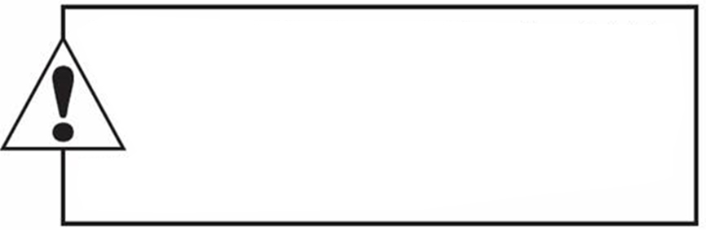
Copyright
This work is protected by United States copyright laws and is provided solely
for the use of instructions in teaching their courses and assessing student
learning. dissemination or sale of any part of this work (including on the
World Wide Web) will destroy the integrity of the work and is not permit-
ted. The work and materials from it should never be made available to
students except by instructors using the accompanying text in their
classes. All recipients of this work are expected to abide by these
restrictions and to honor the intended pedagogical purposes and the needs of
other instructors who rely on these materials.

